Slide 1
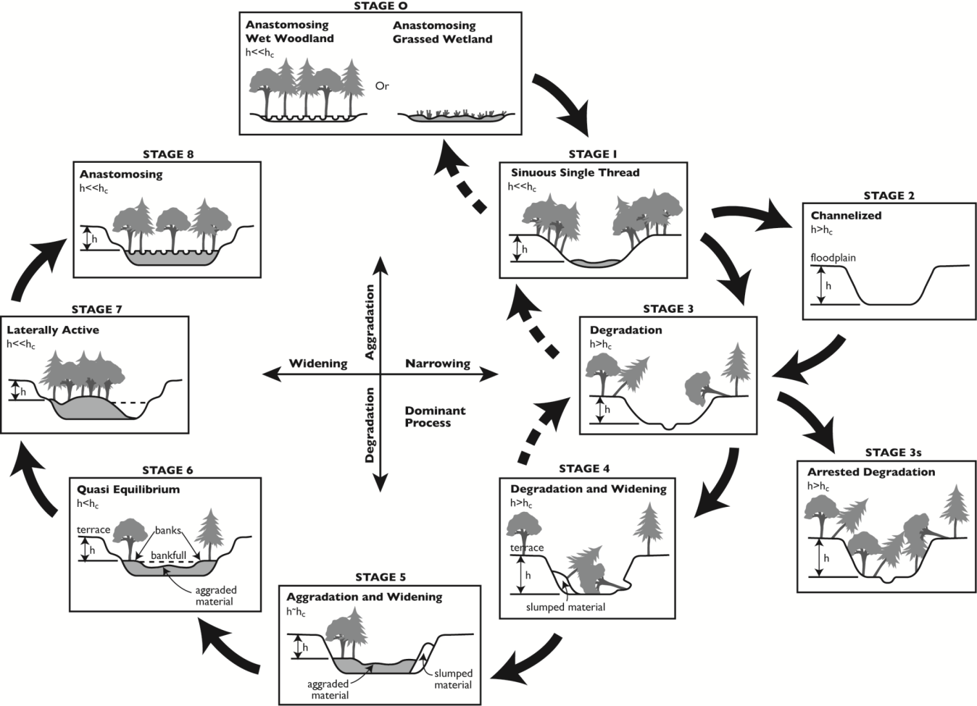
How We Got to Stage 0:
A 10-minute History
Cluer & Thorne, 2013
Johan Hogervorst
Forest Hydrologist, Willamette National Forest

Slide 2
Historic Floodplain Condition in Depositional Environments
  Vegetation diversity
  Elevational diversity
  Multiple flow paths
  Downed wood
  Future wood supply
  High water table
  Beaver dams
  Frequent floodplain wetting
  Maximum patch complexity

Slide 3
Reach-scale processes from Roni and Beechie, 2013
Routing and stream flow
Flood storage
Flow Regime
Sediment retention and storage
Sediment transport
Floodplain building
Sediment Regime
Pool and bar formation
Channel movement
Channel features
Shading
Root reinforcement of banks
Wood supply
Litter fall
Late season water storage (added)
Transport and storage of seeds
and plant propagules
Floodplain
Primary production
Secondary Production
Feeding/predation
Biology
* Stream and Watershed Restoration: A Guide to Restoring Riverine Processes and Habitats -- Copyright © 2013 John Wiley & Sons, Ltd
Notes:
These are the process we try to restore in depositional valleys and these were taken from the book Stream and Watershed Restoration: A Guide to Restoring Riverine Processes and Habitats……
I’ve grouped them into process types just to make them a little easier to understand.
For example,….

Slide 4
Changed Condition in Depositional Environments

Slide 5

Changed Condition in Depositional Environments
Road building

Slide 6
Changed Condition in Depositional Environments
  Road building
  Conifer harvest

Slide 7

Changed Condition in Depositional Environments
  Road building
  Conifer harvest
  Diking and channelization

Slide 8
Changed Condition in Depositional Environments
  Road building
  Conifer harvest
  Diking and channelization
  Blocking or filling side channels

Slide 9

Changed Condition in Depositional Environments
  Road building
  Conifer harvest
  Diking and channelization
  Blocking or filling side channels
  Grazing and farming

Slide 10
Changed Condition in Depositional Environments
  Road building
  Conifer harvest
  Diking and channelization
  Blocking or filling side channels
  Grazing and farming
Leads to:
  Single incised channel
  Loss of water table/wetlands
  Altered vegetation types
  Minimal large wood
  Altered Stream Power –> change from deposition to transport
Water table
Stream Evolution Model, Stages 2-4
Cluer and Thorne, 2013

Slide 11
Historic Floodplain Condition in Depositional Environments
Stream Power Per Unit Width - Low
Flow distributed throughout a roughened surface

Slide 12
Changed Condition from
Depositional to Transport Environments
Stream Power Per Unit Width - High
“fire hose effect”

Slide 13
Reach-scale processes from Roni and Beechie, 2013
Routing and stream flow
Flood storage
Flow Regime
Sediment retention and storage
Sediment transport
Floodplain building
Sediment Regime
Pool and bar formation
Channel movement
Channel features
Shading
Root reinforcement of banks
Wood supply
Litter fall
Late season water storage (added)
Transport and storage of seeds
and plant propagules
Critical to Native Aquatic Species
Floodplain
Primary production
Secondary Production
Feeding/predation
Biology
* Stream and Watershed Restoration: A Guide to Restoring Riverine Processes and Habitats -- Copyright © 2013 John Wiley & Sons, Ltd
Notes:
These are the process we try to restore in depositional valleys and these were taken from the book Stream and Watershed Restoration: A Guide to Restoring Riverine Processes and Habitats……
I’ve grouped them into process types just to make them a little easier to understand.
For example,….

Slide 14

Restoration Solutions:
Channel-centric, form-based restoration (1980s to present)
Advantages:
Easy to count # of structures, pools created and miles treated
Focused treatment that’s relatively inexpensive per site
Disadvantages:
Process and function minimally addressed
Unnatural materials and engineering in stream
Blows out in big storms
Stream power and water table not addressed
Stream Power Per Unit Width

Slide 15
Restoration Solutions:
Stage 0, process-based restoration (2005 to present)
Advantages:
Process and function fully addressed for entire floodplain
Water table restored
Template created for native vegetation recovery
Patch complexity maximized & change anticipated over time
Large storms welcome (stream energy addressed)
Disadvantages:
High level of disturbance initially – turbidity during construction
Tough to monitor with traditional surveys
Social acceptance for a new technique
Stream Power Per Unit Width

Slide 16
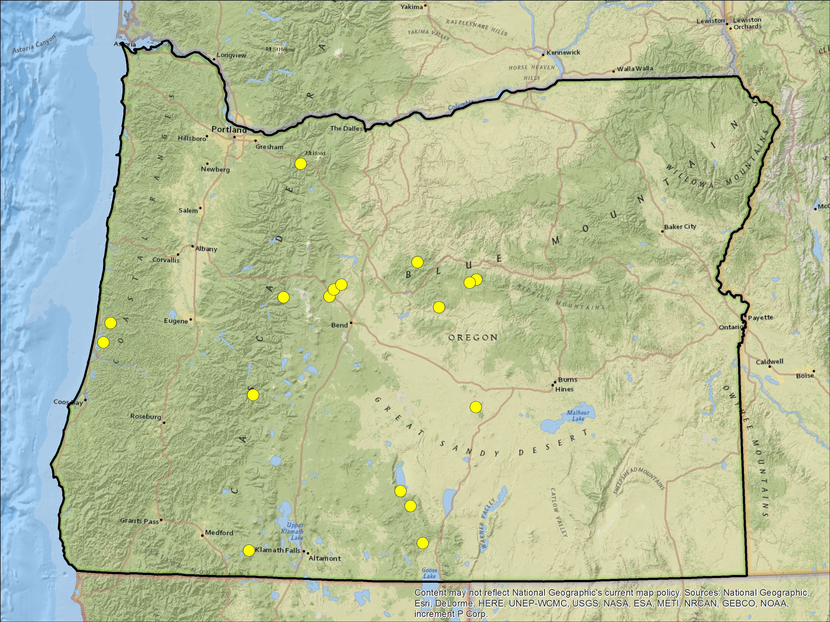
Locations of Forest Service floodplain re-initiation projects in Oregon
Deer Creek
Upper McKenzie River
Willamette NF
Fivemile-Bell
Coastal Lakes Basin
Siuslaw NF
Whychus Creek
Upper Deschutes Basin
Deschutes NF
Staley Creek
Upper Middle Fork Willamette
Willamette NF

Slide 17
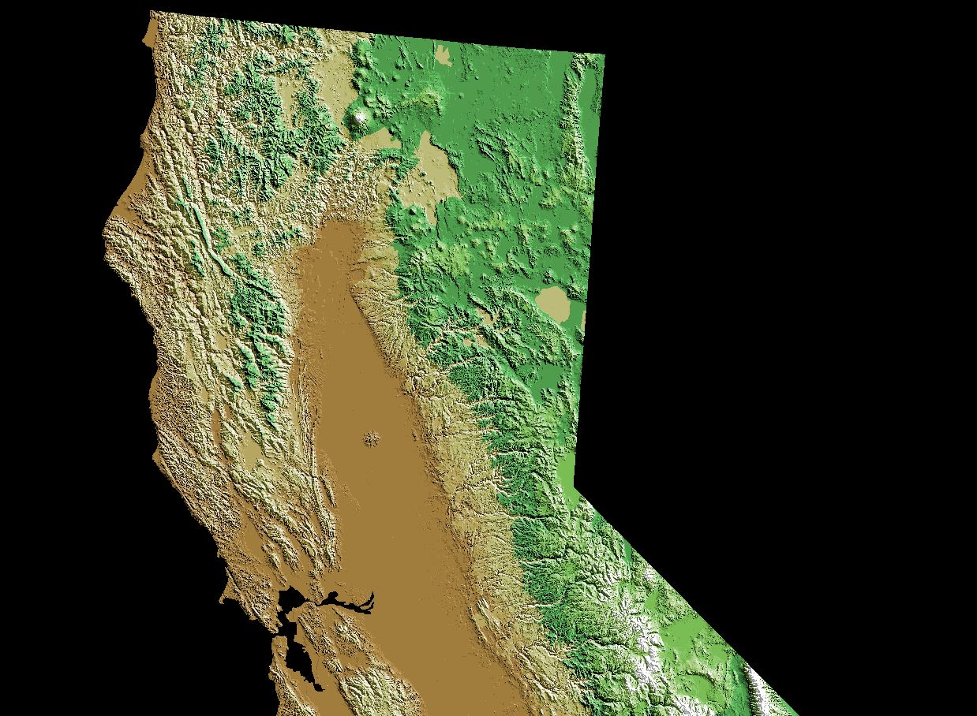
Willow Creek
Lower Russian River
Sonoma Coast State Park

Slide 18
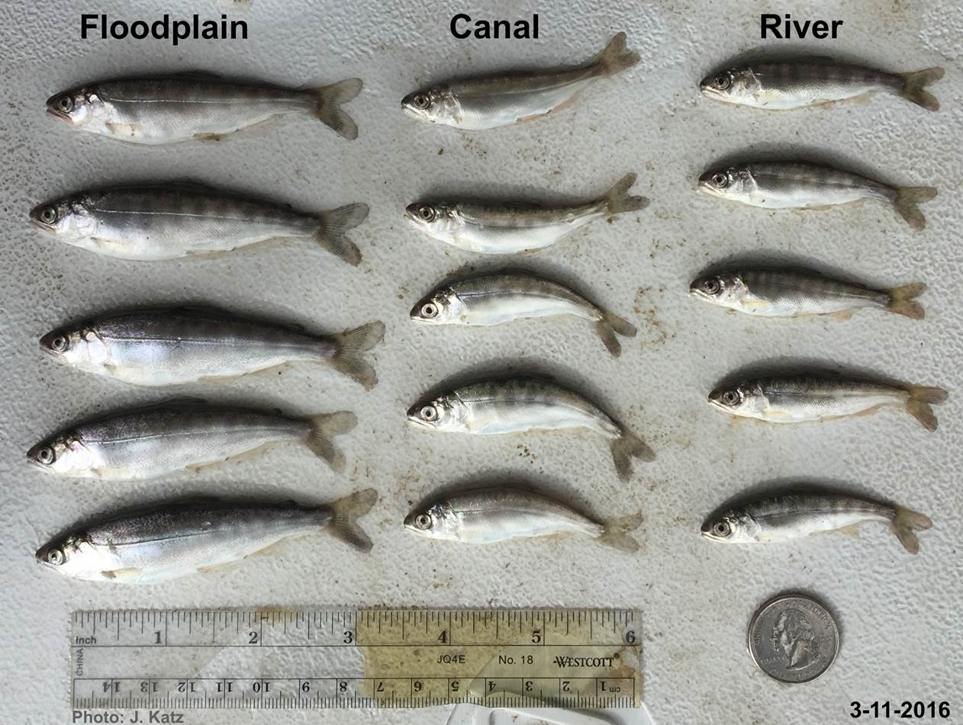
Floodplains are good!
jhogervorst@fs.fed.us

